Slide 1

Weather Application
A Real-Time Weather Information App
by
A.BOOBATHI

Slide 2
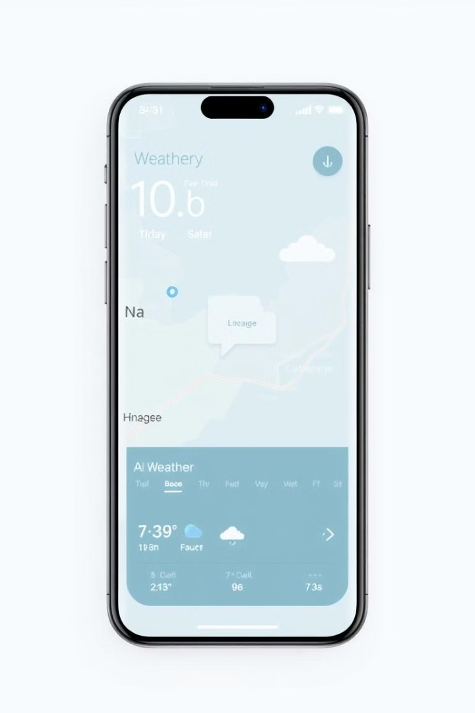
Objective
The java swing based app aims to deliver accurate weather updates for any location while simplifying weather forecasting with a user-friendly interface.

Slide 3
Modules
Login module Signup module
Weather forecast module

Slide 4
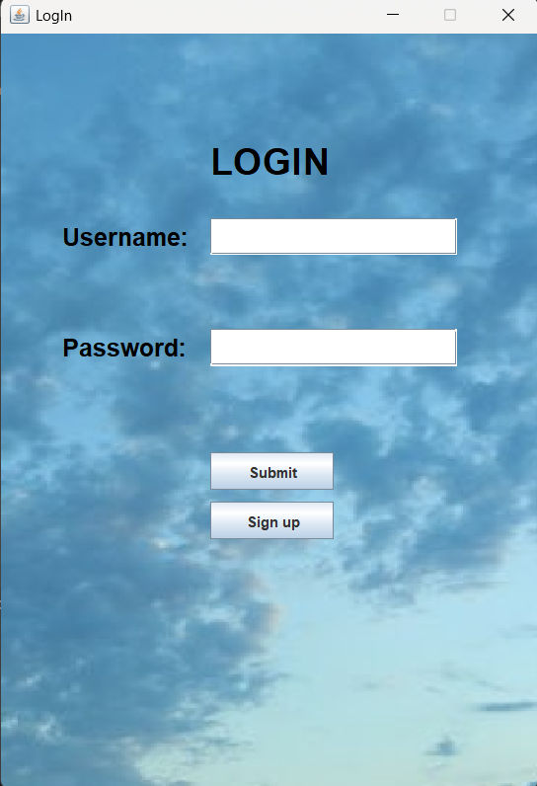
User Login Module
1. Login Module
Purpose: Authenticate users and provide secure access to the application.
Features:
User inputs username and password.
Validation against stored credentials in the database.
Error handling for incorrect username/password or connection issues.
Redirects authenticated users to the Weather App module.

Slide 5
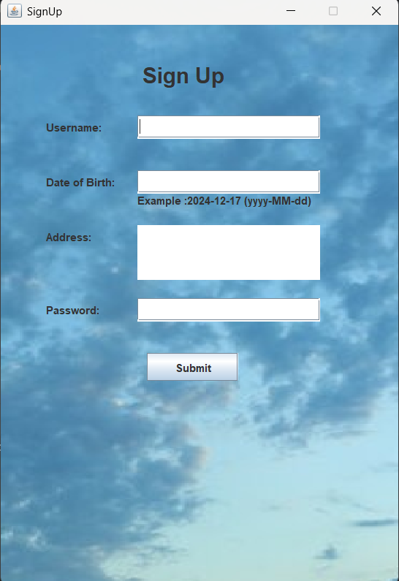
Sign-Up Module
Purpose: Allow new users to register by creating an account.
Features:
Collect user details like username, password, date of birth, and address.
Store user data securely in the database.
Notify the user of successful registration or errors (e.g., duplicate usernames).

Slide 6
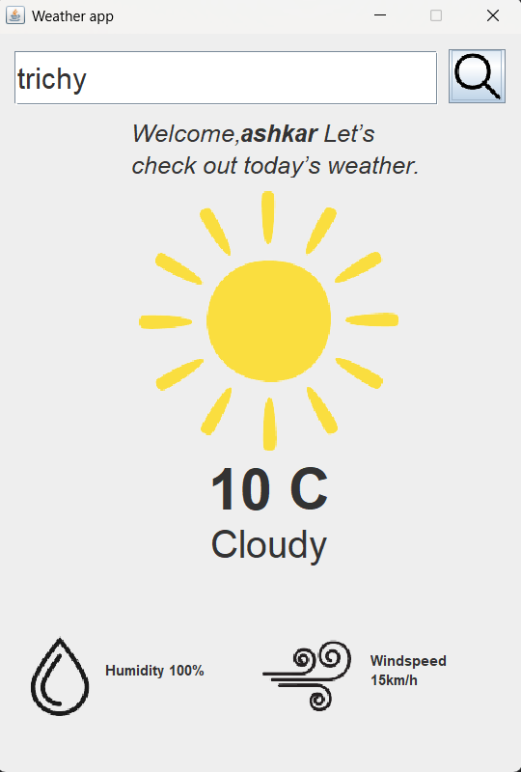
Weather App Module
Purpose: Fetch and display weather data for a given location.
Features:
User inputs location name.
Fetch geographical coordinates using a geolocation API.
Fetch weather data using a weather API based on the coordinates.
Display weather details like temperature, humidity, wind speed, and conditions.
Error handling for invalid locations or API connectivity issues.

Slide 7
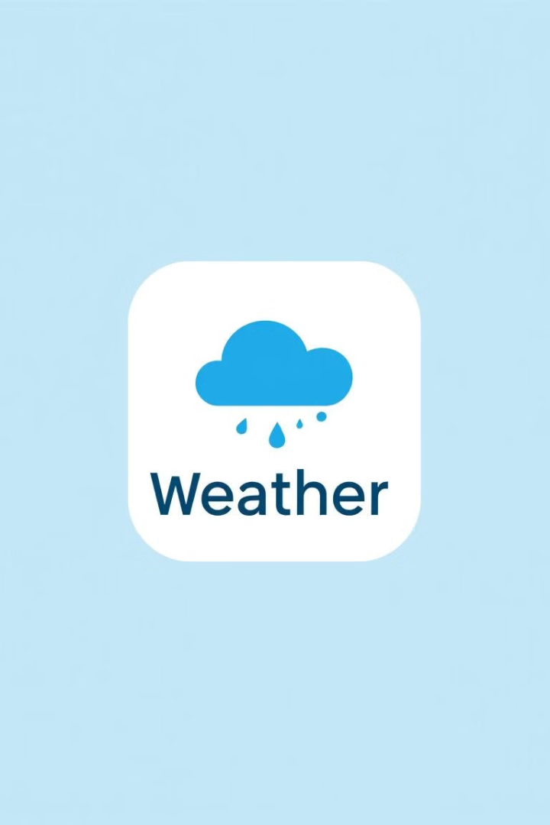
Conclusion and Next Steps
The Weather Application provides a comprehensive solution for accessing real-time weather information. Future development will focus on integrating new features and enhancing user experience.

Slide 8
REFERENCE
WEATHER API :
https://open-meteo.com/
MY SQL :
https://dev.mysql.com/downloads/connector/j/
JSON JAR:
https://code.google.com/archive/p/json-simple/downloads

